Slide 1



Crop Recommendation system
Welcome to this presentation on the Crop Recommendation System, a cutting-edge machine learning application designed to empower farmers and agricultural professionals. This system analyzes various environmental and soil conditions to provide precise, data-driven suggestions for optimal crop selection. Our goal is to help you boost yields, increase profitability, and make more informed decisions for a sustainable future in agriculture.
Notes:
1

Slide 2
Understanding the Core Problem: Suboptimal Crop Selection
Traditional Challenges
Impacts of Mismanagement
Farmers often rely on historical practices, intuition, or limited local knowledge for crop selection. This can lead to suboptimal yields, increased resource waste, and reduced profitability due to crops not being ideally suited for specific conditions.
Incorrect crop choices can deplete soil nutrients, exacerbate water scarcity, and increase susceptibility to pests and diseases. The long-term effects include soil degradation, decreased productivity, and significant financial losses for farmers.
Over-reliance on experience
Environmental degradation
Limited data analysis capabilities
Economic instability
Risk of crop failure
Reduced food security
Notes:
2

Slide 3
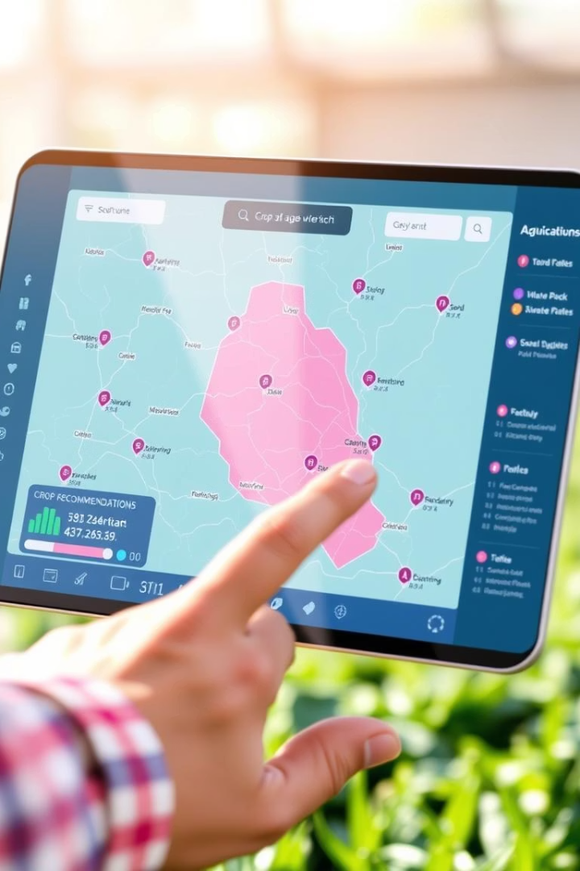




Introducing the Crop Recommendation System
The Crop Recommendation System is an innovative machine learning solution engineered to guide farmers in selecting the most appropriate crops for their specific conditions. By integrating diverse environmental and soil data, the system generates personalized recommendations, fostering enhanced productivity and economic viability.
Optimized Yields
Increased Profitability
Sustainable Practices
Select crops that thrive in your specific conditions.
Maximize returns by making data-driven choices.
Promote ecological balance and soil health.
Informed Decisions
Leverage predictive models for precise guidance.
Notes:
3

Slide 4












Key Factors Influencing Crop Suitability
Our system meticulously analyzes a comprehensive suite of environmental and soil parameters to deliver highly accurate crop recommendations. Understanding these factors is crucial for successful cultivation and optimal resource allocation.
Soil pH
Climate
Optimal acidity/alkalinity for nutrient absorption.
Regional weather patterns, seasons, and temperature ranges.
Soil Type
Rainfall
Texture, composition, and nutrient content of the soil.
Average precipitation levels and distribution.
Humidity
Temperature
Moisture content in the air affecting plant health.
Daily and seasonal temperature fluctuations.
Notes:
4

Slide 5





The System's Operational Workflow
The Crop Recommendation System operates through a well-defined workflow, ensuring accurate and reliable recommendations. Each stage is critical to transforming raw data into actionable insights for farmers.
Input Data Collection
Users input soil parameters, climate data, and geographic location through a user-friendly interface.
Data Preprocessing
Raw data is cleaned, normalized, and transformed to prepare it for machine learning models, handling missing values and categorical variables.
Machine Learning Models
Various algorithms like decision trees, random forests, and SVMs are employed to build robust predictive models based on historical agricultural data.
Model Training & Evaluation
Models are rigorously trained on historical datasets and evaluated using performance metrics to ensure their accuracy and reliability.
Crop Recommendation
Based on the trained models, the system generates and presents the most suitable crop recommendations tailored to the input parameters.
Notes:
5

Slide 6




Powering the System: Machine Learning Models
The intelligence behind our recommendations stems from advanced machine learning algorithms. Each model plays a unique role in identifying patterns and making accurate predictions from complex agricultural datasets.
Decision Trees
Random Forests
Simple yet powerful, these models classify crops based on a series of decisions derived from input features, providing clear pathways to recommendations.
An ensemble method that combines multiple decision trees to improve accuracy and reduce overfitting, offering robust and reliable predictions.
Support Vector Machines (SVM)
Gradient Boosting
Effective in high-dimensional spaces, SVMs create optimal hyperplanes to categorize crops, distinguishing between suitable and unsuitable options with precision.
A powerful technique that builds models sequentially, where each new model corrects errors of previous ones, leading to highly accurate and refined recommendations.
Notes:
6

Slide 7

Technological Foundations
The Crop Recommendation System is built upon a robust foundation of cutting-edge programming languages and libraries. These technologies ensure efficiency, scalability, and user-friendliness, from data processing to web application development.
Python
The primary programming language for model development, data preprocessing, and orchestrating the entire web application.
Scikit-learn
A comprehensive machine learning library, integral for training, evaluating, and deploying our predictive models with high performance.
Pandas & NumPy
Essential libraries for efficient data manipulation, numerical computing, and handling large datasets during the preprocessing and analysis phases.
Flask
The lightweight web framework powering the user interface, ensuring a seamless and responsive experience for farmers accessing recommendations.
Notes:
7

Slide 8




Impact and Benefits for Agricultural Stakeholders
The implementation of the Crop Recommendation System brings tangible benefits across the agricultural value chain, promoting both individual farm prosperity and broader food security.
Enhanced Resource Efficiency
Minimize water and fertilizer waste by selecting crops with precise needs.
Increased Farmer Income
Higher yields and optimized choices lead directly to greater profitability.
Sustainable Agricultural Practices
Contribute to healthier soil and reduced environmental impact through informed decisions.
Improved Food Security
More efficient crop production contributes to a stable and abundant food supply for communities.
Notes:
8

Slide 9

Conclusion and Next Steps
The Crop Recommendation System represents a significant leap forward in precision agriculture. By combining machine learning with essential agricultural data, we empower farmers to make smarter, more profitable, and sustainable decisions.
95%
30%
Accuracy Rate
Yield Increase
Of crop recommendations based on our advanced models.
Potential average yield increase for adopting farmers.
10K+
Data Points
Used in our historical dataset for training and prediction.
Our commitment is to continue refining this system, integrating more data sources, and enhancing its capabilities to serve the agricultural community even better. We invite you to explore how this technology can transform your farming operations. Thank you for your time and attention.
Notes:
9

